Slide 1
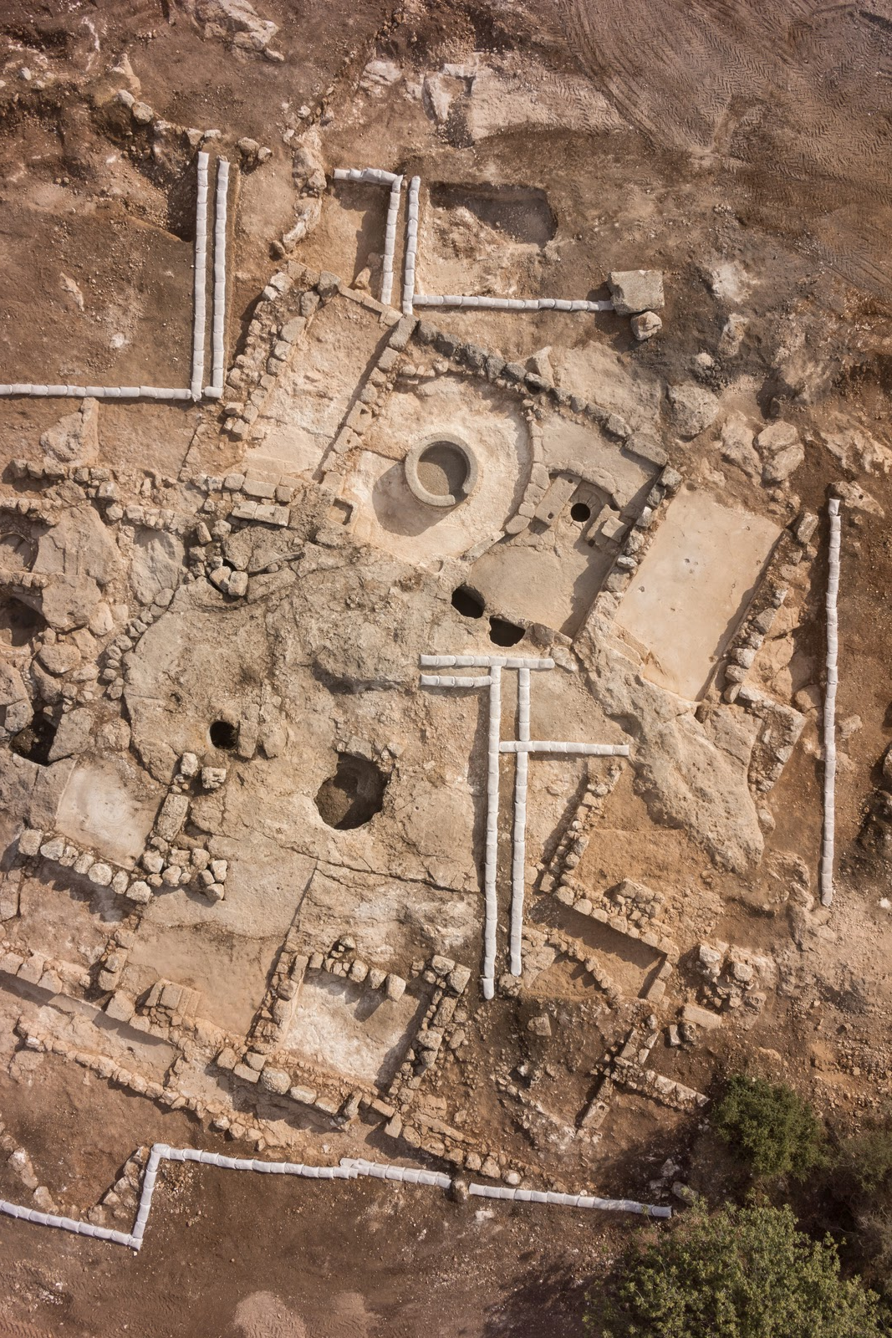
CONSERVING THE PAST
L.G: To understand why conservation is important in terms of historical sites.
C.S: Written down the 5 key reasons for conservation and answered the questions.

Slide 2
Write the following 5 points down in your book.

Slide 3
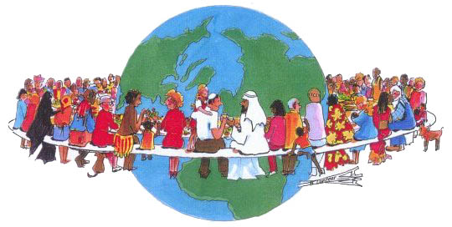
1. Evolution of human consciousness is a continuous process:
We learn about the past to influence the way we live in the future.

Slide 4

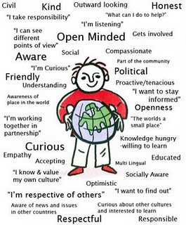
2. We are not born capable of judging fairly and wisely:
We learn how to be critical and analytical thinkers and good global citizens

Slide 5
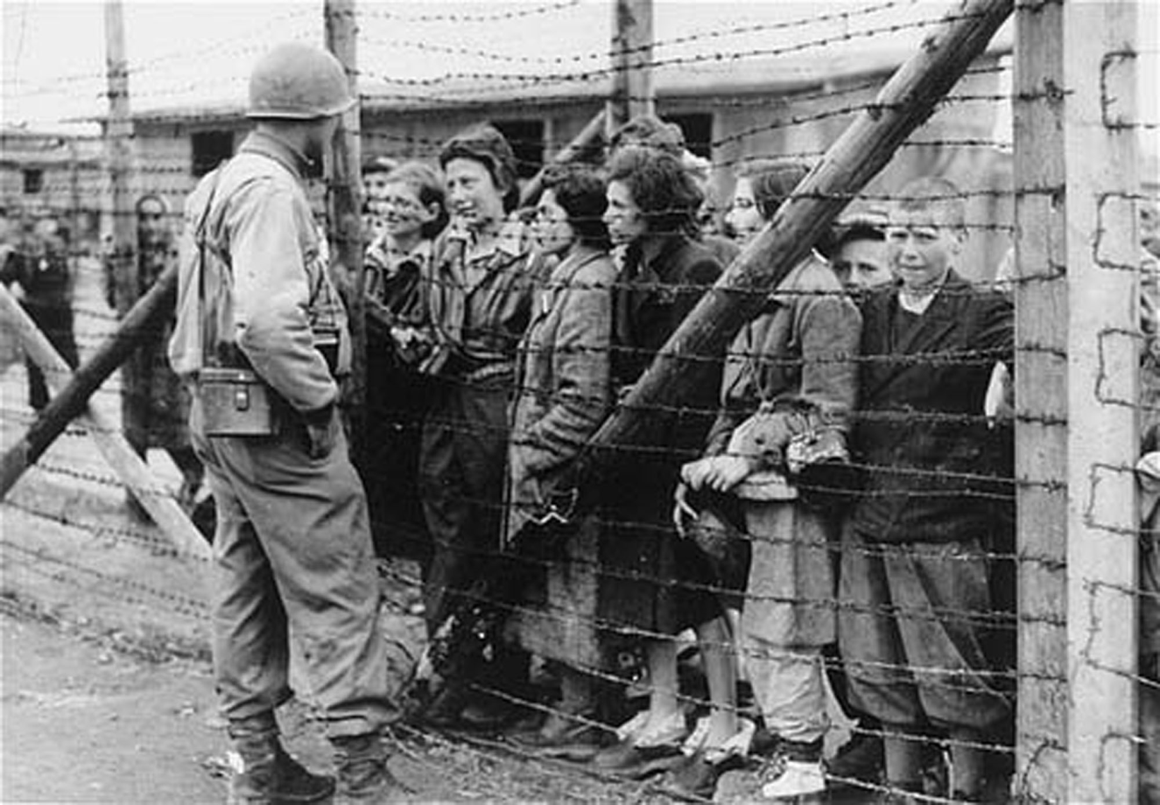
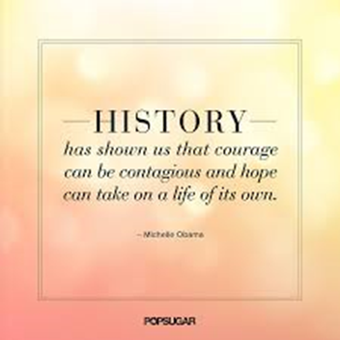
3. Every historical site has an important story to tell:
Stories from history have inspired many people to strengthen their convictions and commitment to fight injustice and oppression.

Slide 6
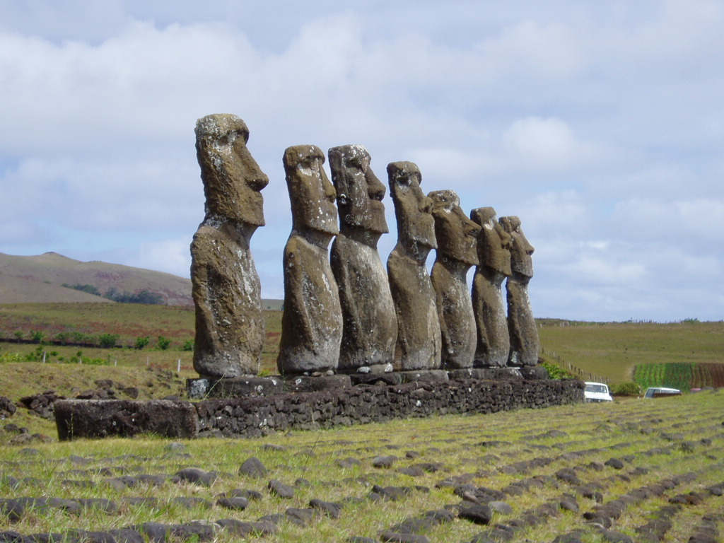
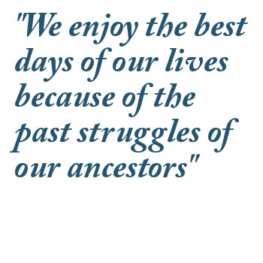
4. Heritage sites are our connection to the past:
Heritage sites are living monuments and record certain events which is a connection to our past. It proves the existence of our ancestors.

Slide 7


5. Heritage sites are great for economics!
Heritage conservation has proven to be a thriving place for entrepreneurship and innovation.
It has also shown increases property values.
Also, since the work is very labour intensive, it actually ends up creating more jobs!
Not to mention the tourist industry…

Slide 8
THINK TASK - answer the following questions:
What is a museum?
What are the functions of a museum?
A museum can be defined as:
i. a non-profit making institution
ii. a permanent institution
iii. providing a service to society
The museum:
i. acquires
ii. conserves
iii. communicates
iv. exhibits
v. researches

